Slide 1

Launching new EC2 from Visual Studio Code & Jupyter Notebook
Ankita Phadke
03/09/23

Slide 2
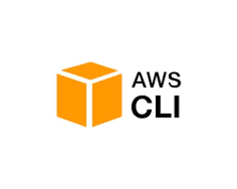
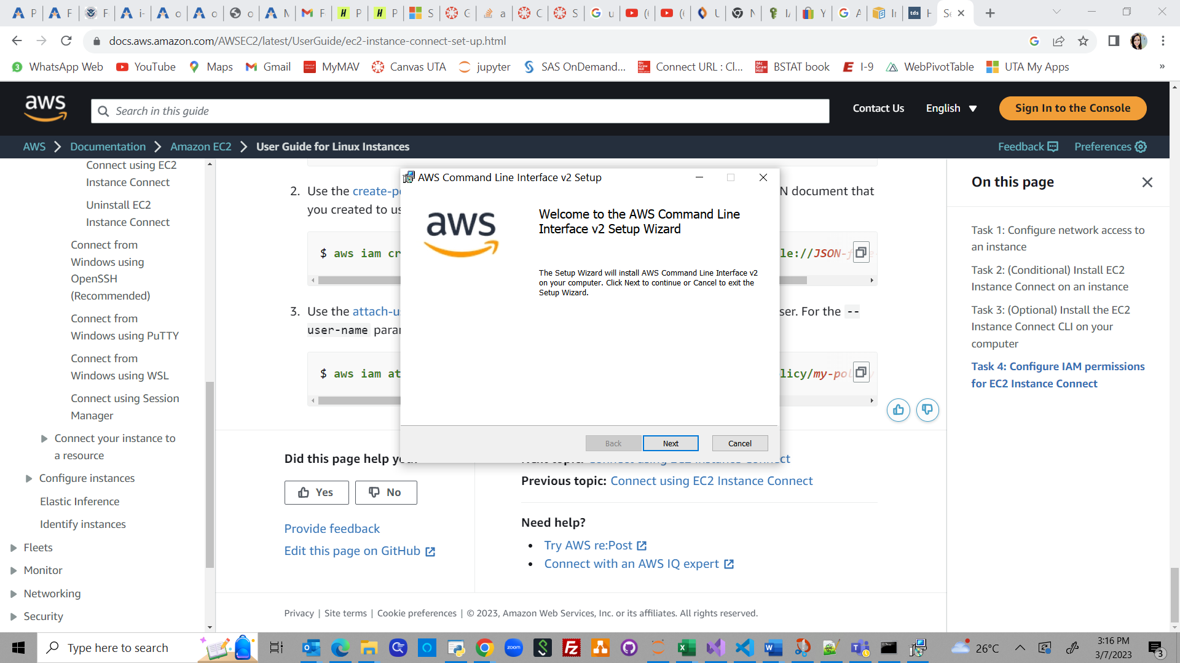
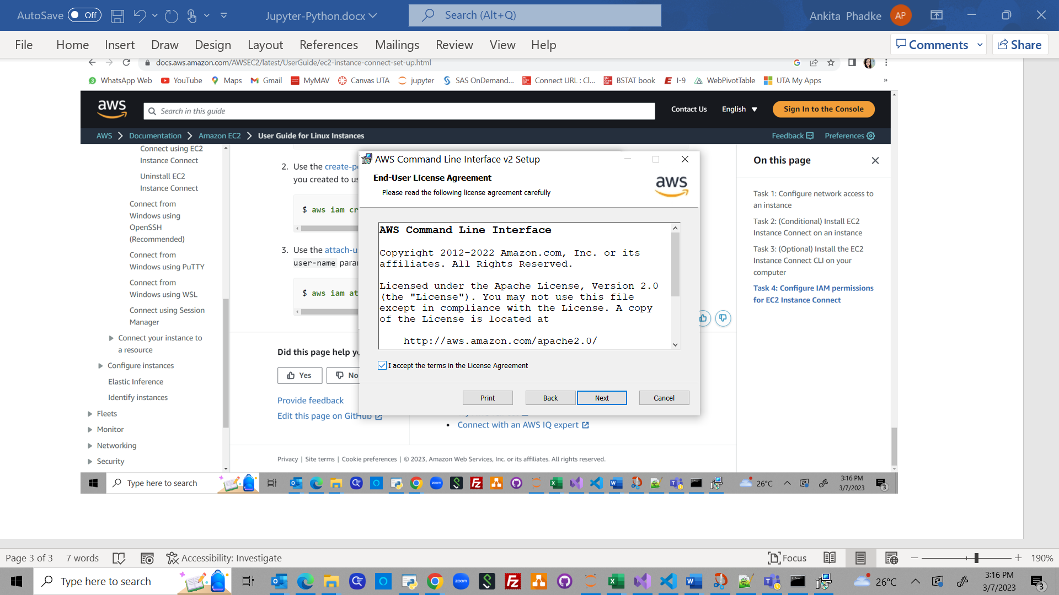
Downloading & installing AWS CLI
URL: https://docs.aws.amazon.com/cli/latest/userguide/getting-started-install.html#getting-started-install-instructions
1. Enter the AWS CLI setup
2. Accept license agreement

Slide 3
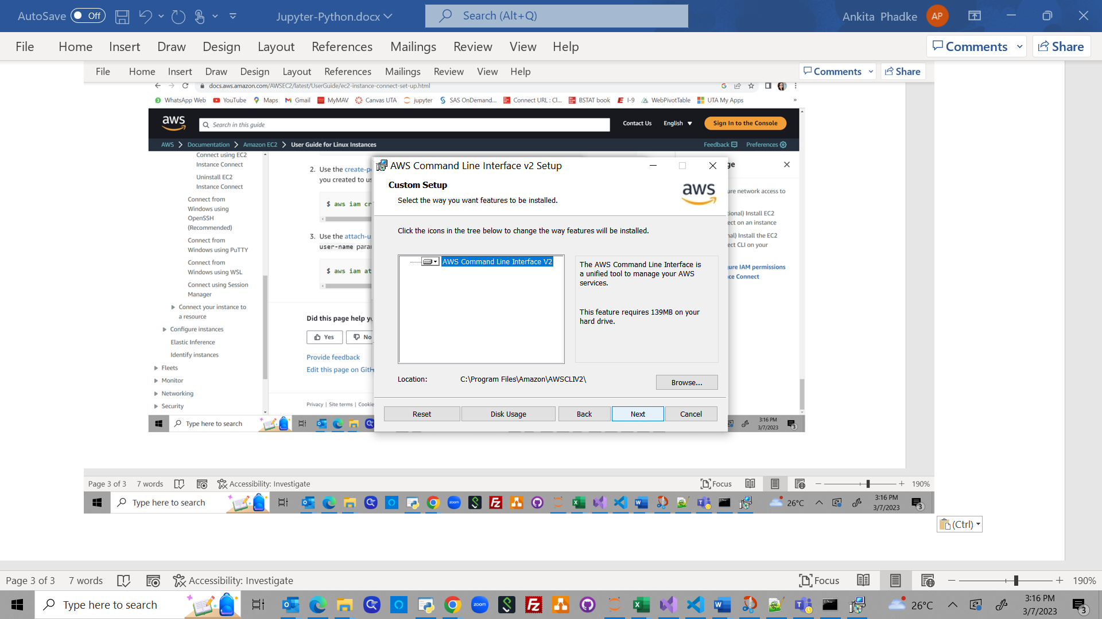
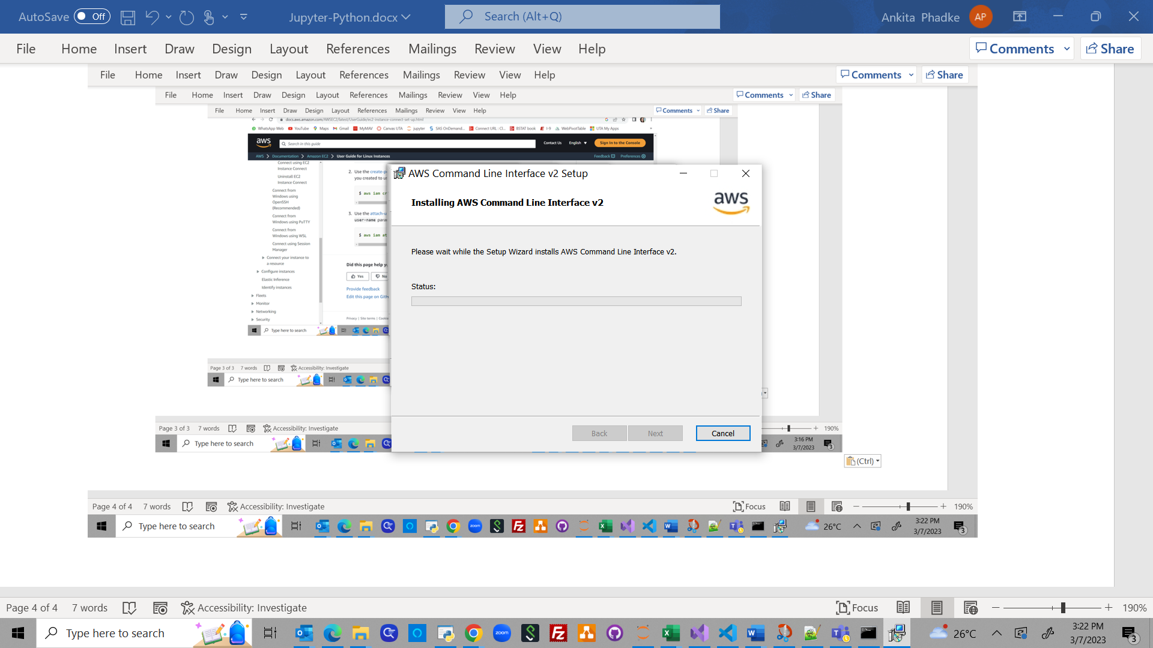
Downloading & installing AWS CLI
3. Continue the setup
4. Complete the setup

Slide 4
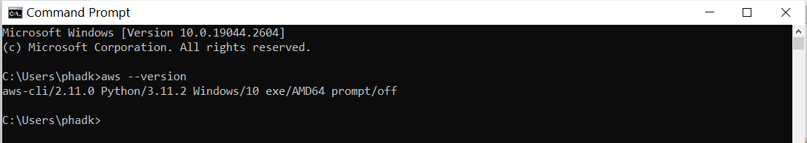
Test installed AWS CLI
Test if the installed AWS CLI is working correctly or not
Run a test AWS Command like aws - - version to check the version

Slide 5
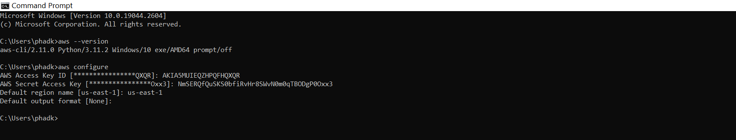
Configure the AWS CLI
Configure the AWS CLI using credentials of the IAM user created

Slide 6
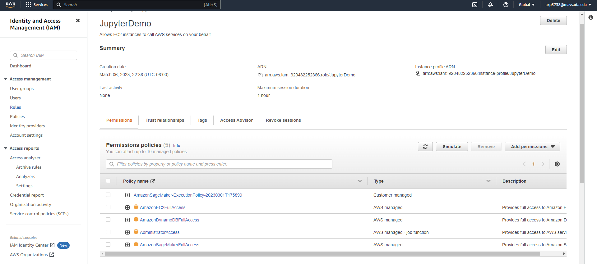

Using Jupyter Notebook to create new EC2
1) Using the Python code & boto3:
Can be done by using the same setup from Amazon Sagemaker to launch the Jupyter Notebook
Used IAM role, instead of IAM user, who needs the ‘AmazonEC2FullAccess’ permission to be able to launch new EC2

Slide 7
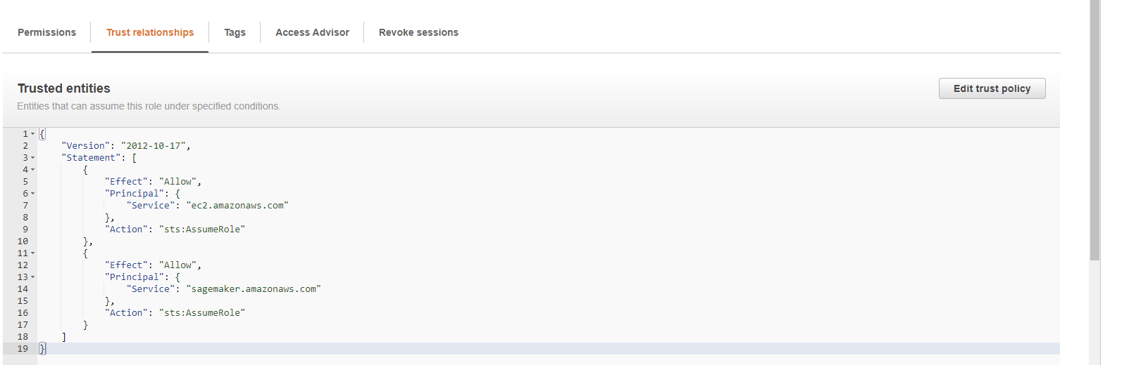
Using Jupyter Notebook to create new EC2
Trusted entities needs to be modified
To add the permissions for EC2 and for accessing Sagemaker

Slide 8
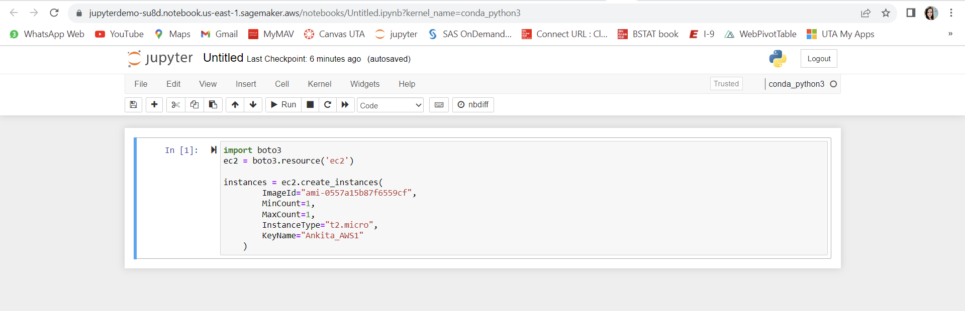
Using Jupyter Notebook to create new EC2
Below code can be used to create new EC2 with basic configuration from Jupyter Notebook
Reference: https://blog.knoldus.com/how-to-create-ec2-instance-using-python3-with-boto3
New EC2 can be seen up and running

Slide 9
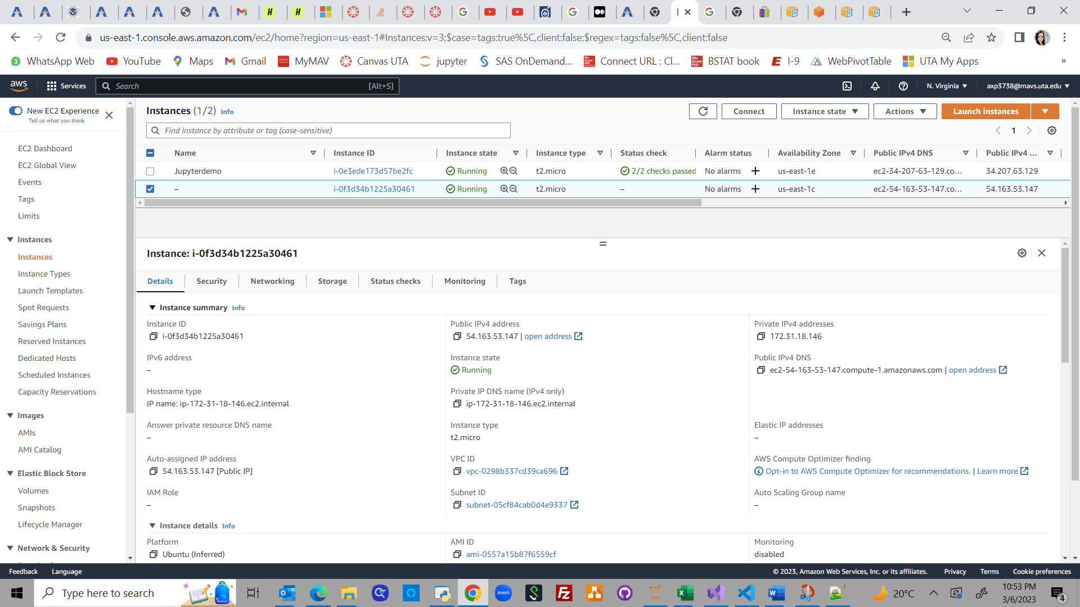
Using Jupyter Notebook to create new EC2

Slide 10
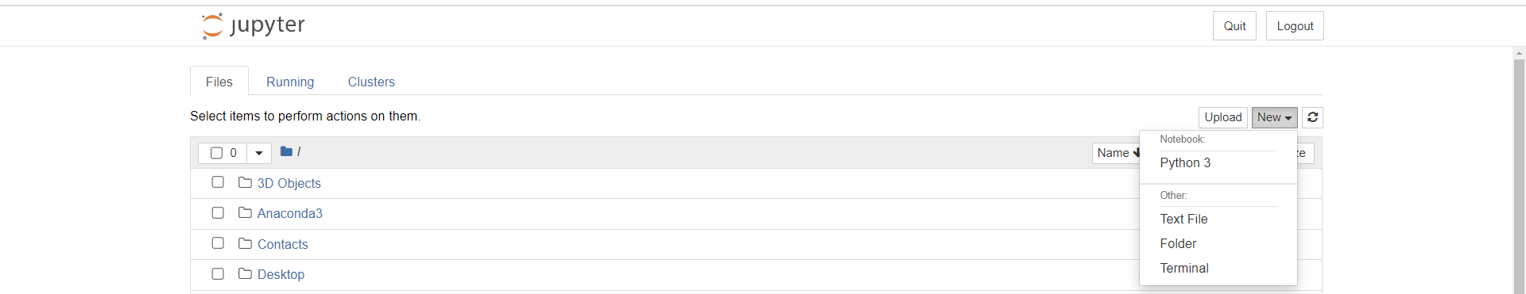


Using Jupyter Notebook to create new EC2
2) Using AWS CLI options:
Open Jupyter Notebook & select New option, choose Terminal to open new terminal window

Slide 11
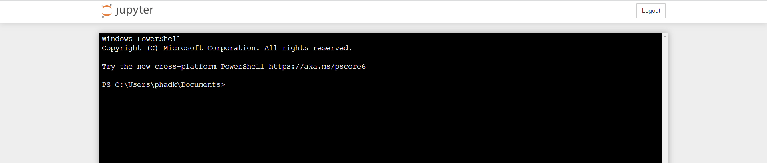
Using Jupyter Notebook to create new EC2
Below window opens up

Slide 12
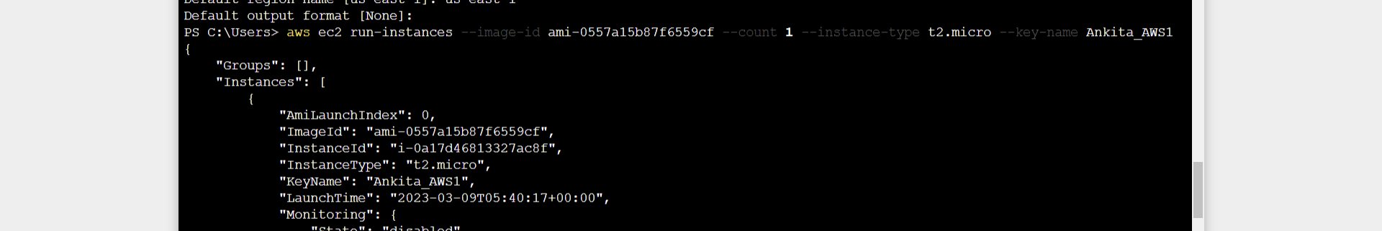
Using Jupyter Notebook to create new EC2
Use the below command to create new EC2
Command used : aws ec2 run-instances
Attributes to be specified:
Ami id
Count (min/max count)
Type: t2-micro
Key-name: .pem file name

Slide 13
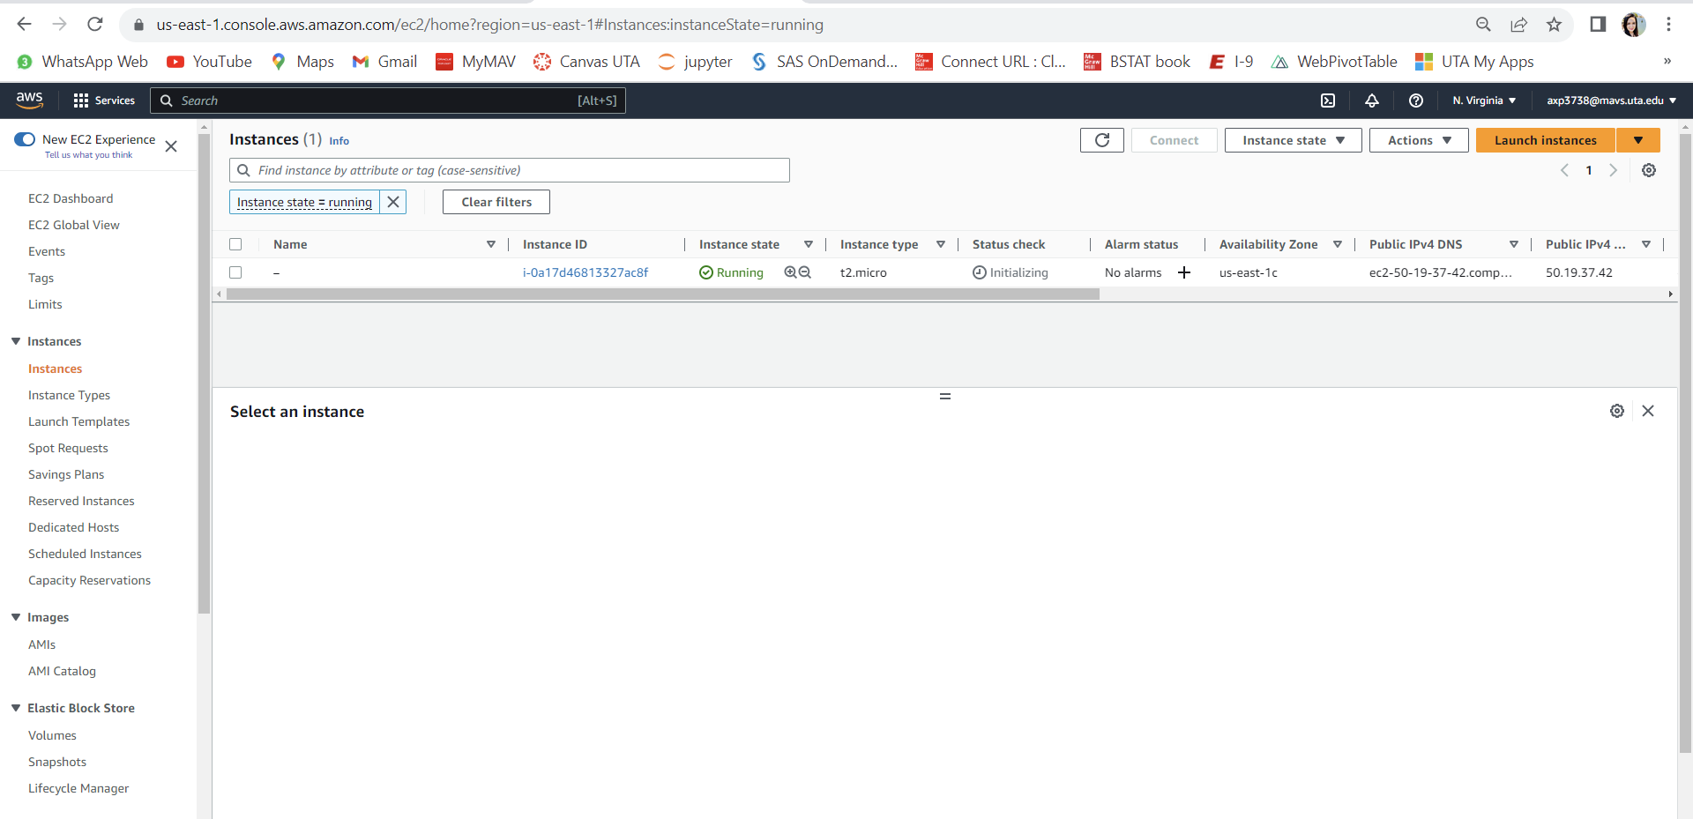
Using Jupyter Notebook to create new EC2
EC2 can be seen up and running

Slide 14
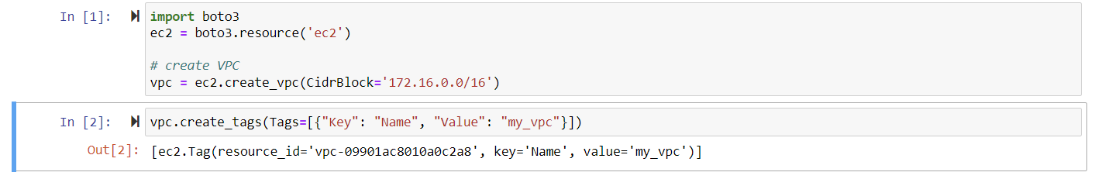

Using Jupyter Notebook to create VPC
1) Using the Python code & boto3:
Reference: https://www.ipswitch.com/blog/how-to-create-and-configure-an-aws-vpc-with-python

Slide 15
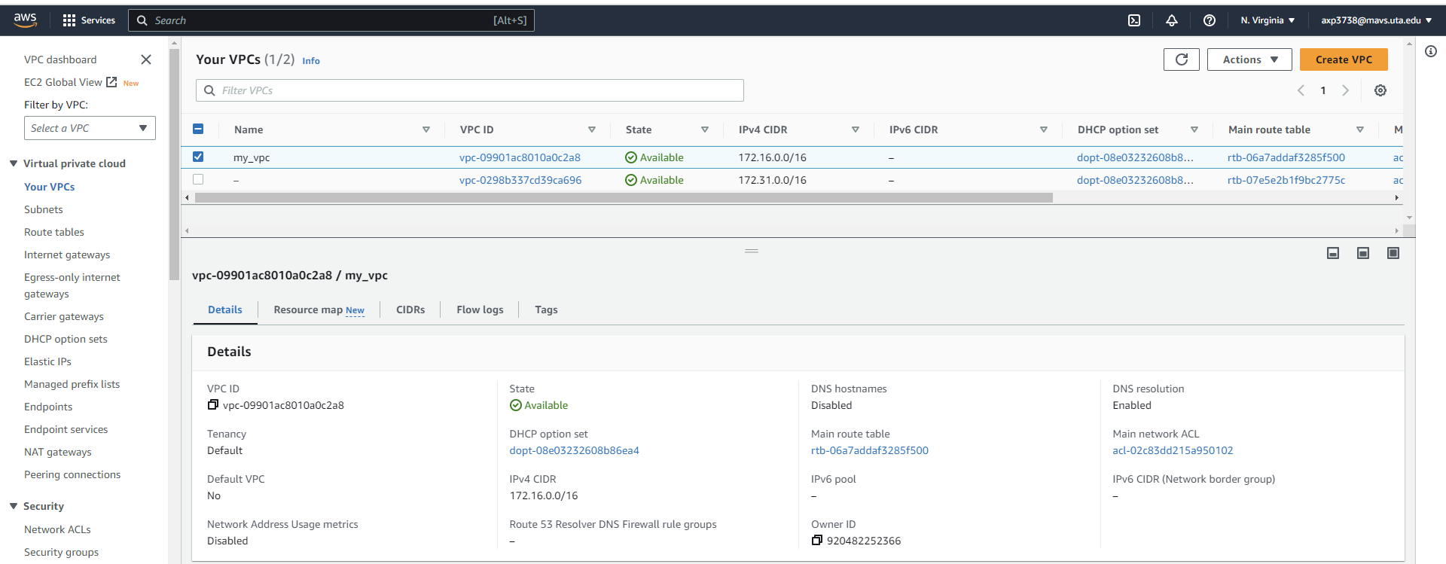
Using Jupyter Notebook to create VPC
VPC can be seen up and running

Slide 16
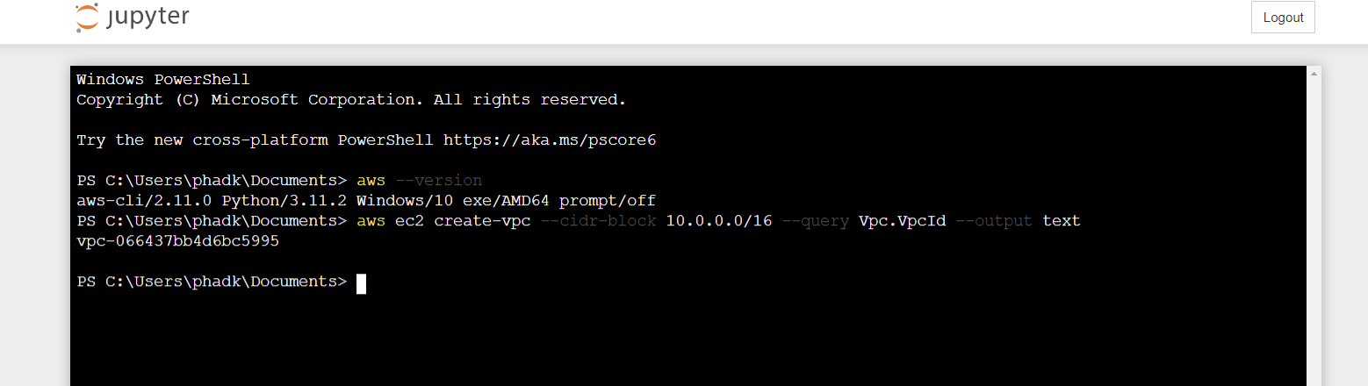
Using Jupyter Notebook to create VPC
2) Using AWS CLI options:
VPC can be created using aws ec2 create-vpc command

Slide 17
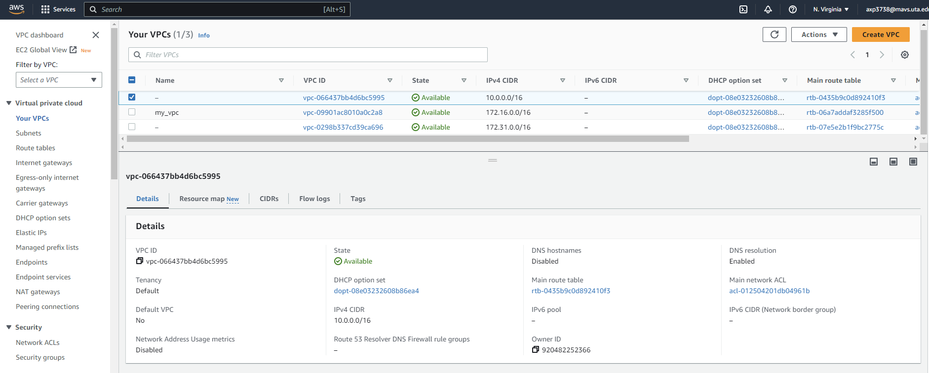
Using Jupyter Notebook to create VPC
VPC can be seen up and running

Slide 18
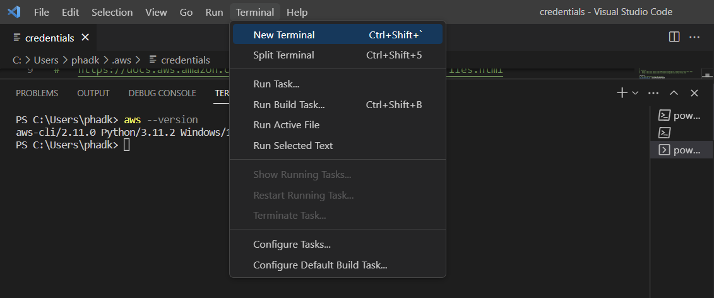
Using Visual Studio Code to create new EC2
1) Using CLI option
Open Terminal -> New Terminal

Slide 19
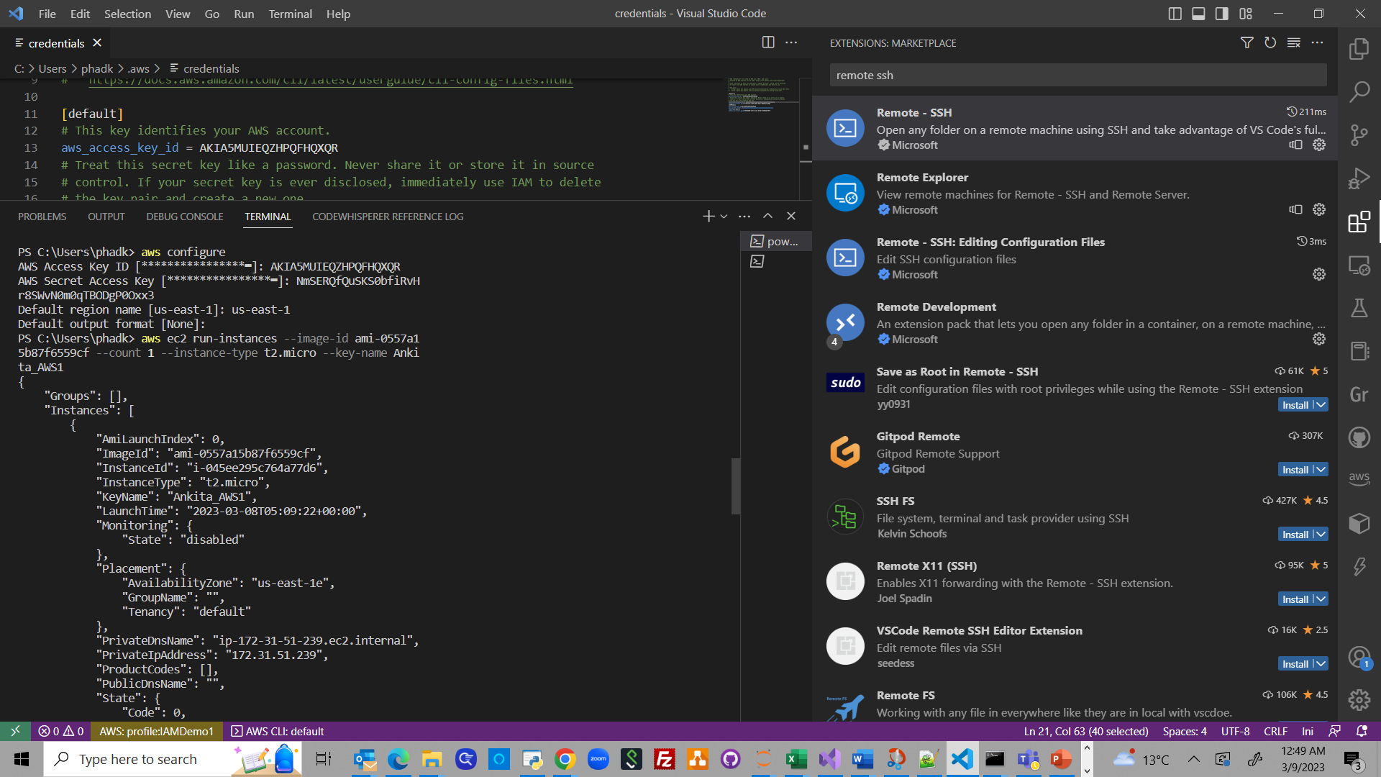
Using Visual Studio Code to create new EC2
Run the commands: aws configure and aws ec2 run-instances

Slide 20
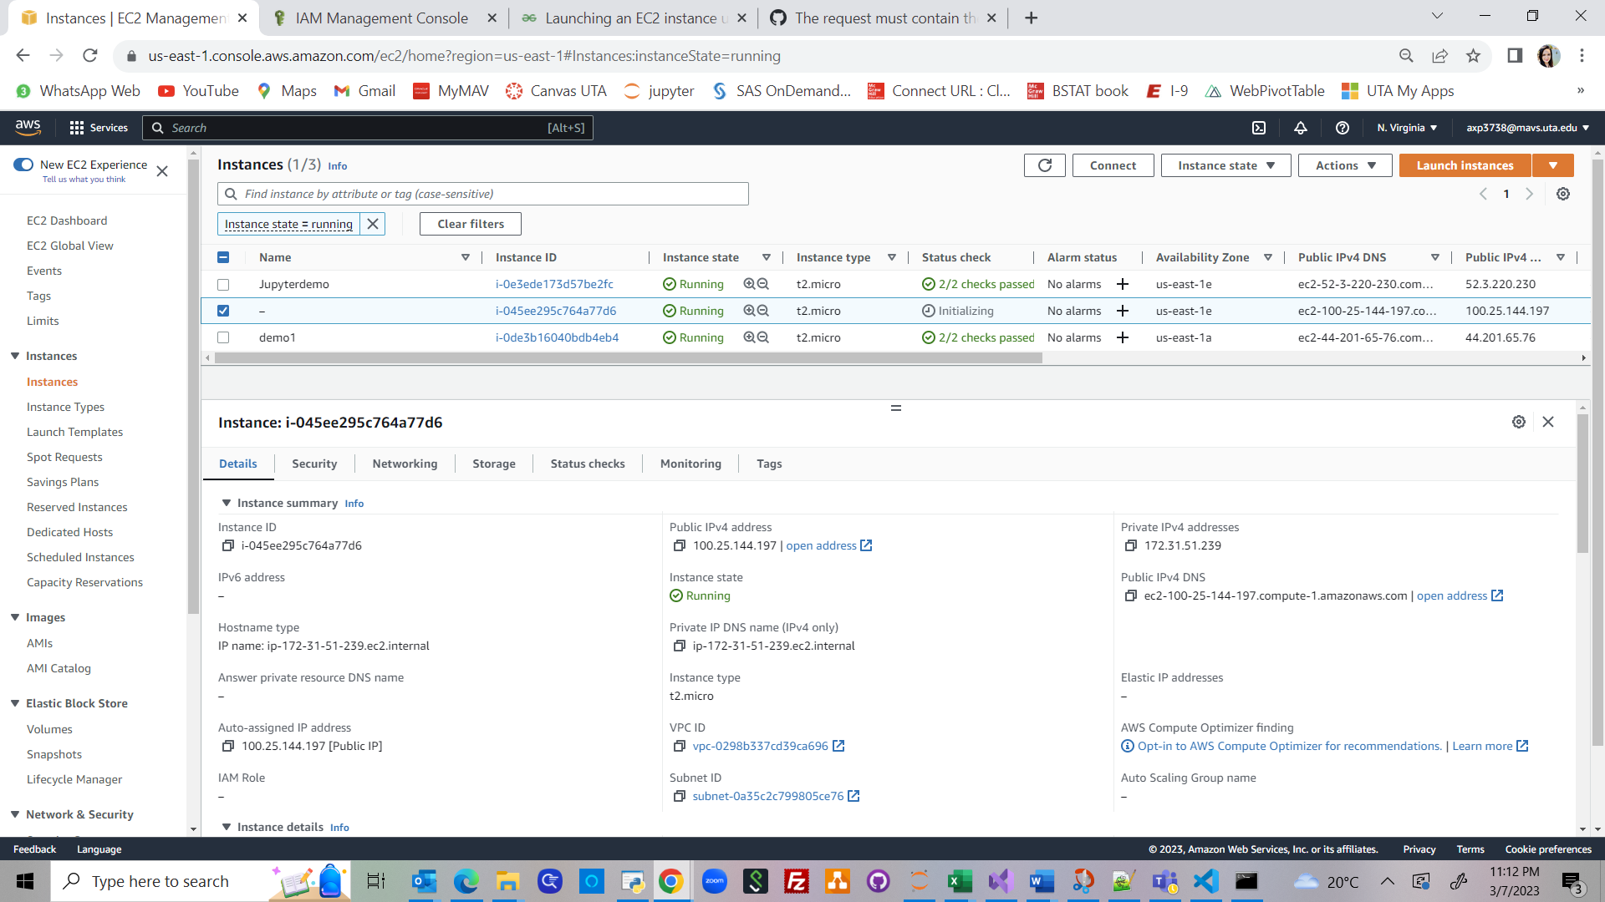



Using Visual Studio Code to create new EC2
New EC2 can be seen up and running

Slide 21
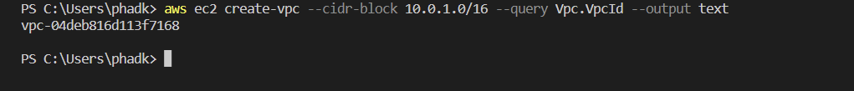
Using Visual Studio Code to create new VPC
Run the command to create VPC: aws ec2 create-vpc
VPC can be seen up & running

Slide 22
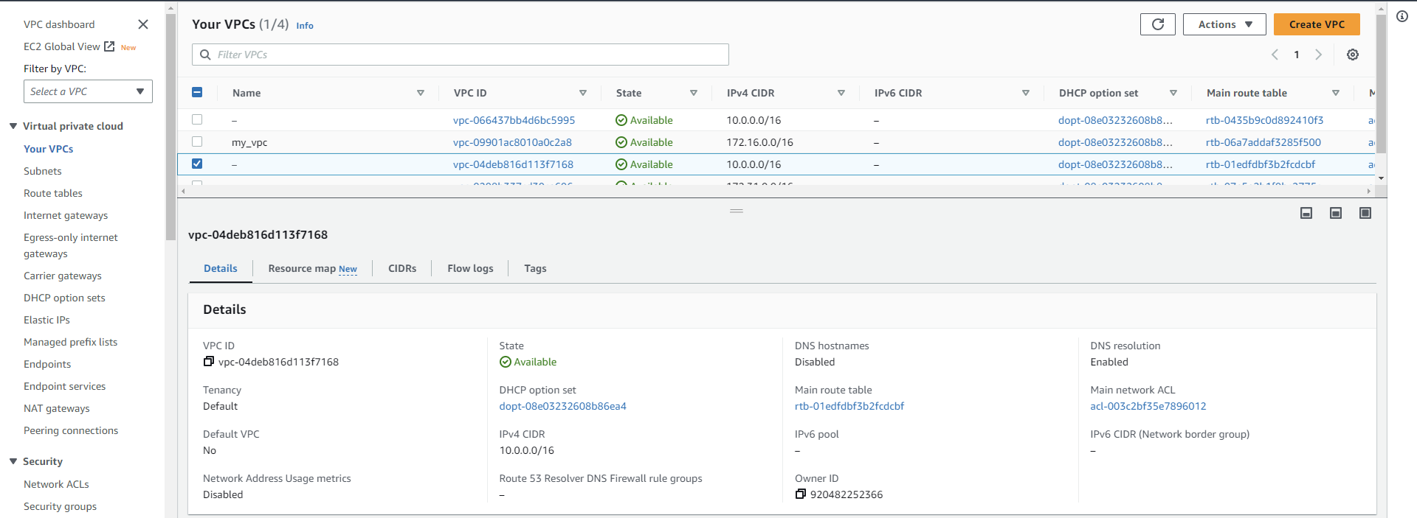
Using Visual Studio Code to create new VPC

Slide 23
References:
https://www.ipswitch.com/blog/how-to-create-and-configure-an-aws-vpc-with-python
https://handsonaws.com/blog/power-of-jupyter-with-aws-cli/#create-a-jupyter-notebook-for-cli
https://pypi.org/project/awscli/
https://docs.aws.amazon.com/vpc/latest/userguide/vpc-subnets-commands-example.html
https://www.geeksforgeeks.org/launching-an-ec2-instance-using-aws-cli/
https://dev.to/cindyledev/remote-development-with-visual-studio-code-on-aws-ec2-4cla
https://medium.com/@christyjacob4/using-vscode-remotely-on-an-ec2-instance-7822c4032cff

